Slide 1


Introduction to Scikit-Learn
Notes:
Welcome everyone to this presentation on Scikit-Learn. Today, we'll dive into what Scikit-Learn is,
explore its capabilities, discuss its pros and cons, and look at some practical examples
of classification and regression. We'll wrap up with a live demo to see Scikit-Learn in action.

Slide 2

What is Scikit-Learn?
A machine learning library in Python, built on top of NumPy, SciPy, and Matplotlib. Designed for simple and efficient predictive data analysis.
Notes:
So, what is Scikit-Learn? Scikit-Learn is a powerful machine learning library in Python.
It’s built on top of NumPy, SciPy, and Matplotlib, making it well-integrated with the scientific
Python ecosystem. The library is designed to be simple and efficient for predictive
data analysis, offering easy-to-use tools for building machine learning models.

Slide 3
What Can You Do with Scikit-Learn?
Classification
Regression
Clustering
Identifying categories, such as spam or not spam.
Predicting continuous values, such as house prices.
Grouping unlabeled data into clusters.
Notes:
Scikit-Learn offers a wide range of functionalities for different machine learning tasks.
For instance, it’s great for classification tasks, like identifying whether an email is spam
or not. It’s also used for regression, such as predicting house prices. If you need to group
unlabeled data into clusters, Scikit-Learn has clustering algorithms. And for simplifying data,
dimensionality reduction techniques are available.

Slide 4
Pros of Scikit-Learn
1
Easy to Use
2
Extensive Documentation
Simple and consistent API.
Comprehensive guide and practical examples.
3
Active Community
4
Compatible
Large number of users and contributors.
Integration with other popular Python libraries.
Notes:
Scikit-Learn has several advantages. It’s easy to use, with a simple and consistent API
that even beginners can quickly grasp. The documentation is extensive, with comprehensive
guides and practical examples. There’s a large and active community of users and contributors,
which means plenty of support and continuous improvements. Plus, it integrates seamlessly with
other popular Python libraries, enhancing its versatility.

Slide 5
Cons of Scikit-Learn
Limitations with Large Data
Focus on Simple Models
Performance
Can be slower compared to libraries optimized for GPU.
Not ideal for large datasets.
Lacks support for more complex deep learning models.
Notes:
However, there are some limitations. Scikit-Learn may not be ideal for handling
very large datasets because it primarily operates in-memory. It focuses on simpler
models and lacks support for more complex deep learning models, which are better
handled by libraries like TensorFlow or PyTorch. Performance-wise, it can be slower
compared to libraries optimized for GPU computations

Slide 6
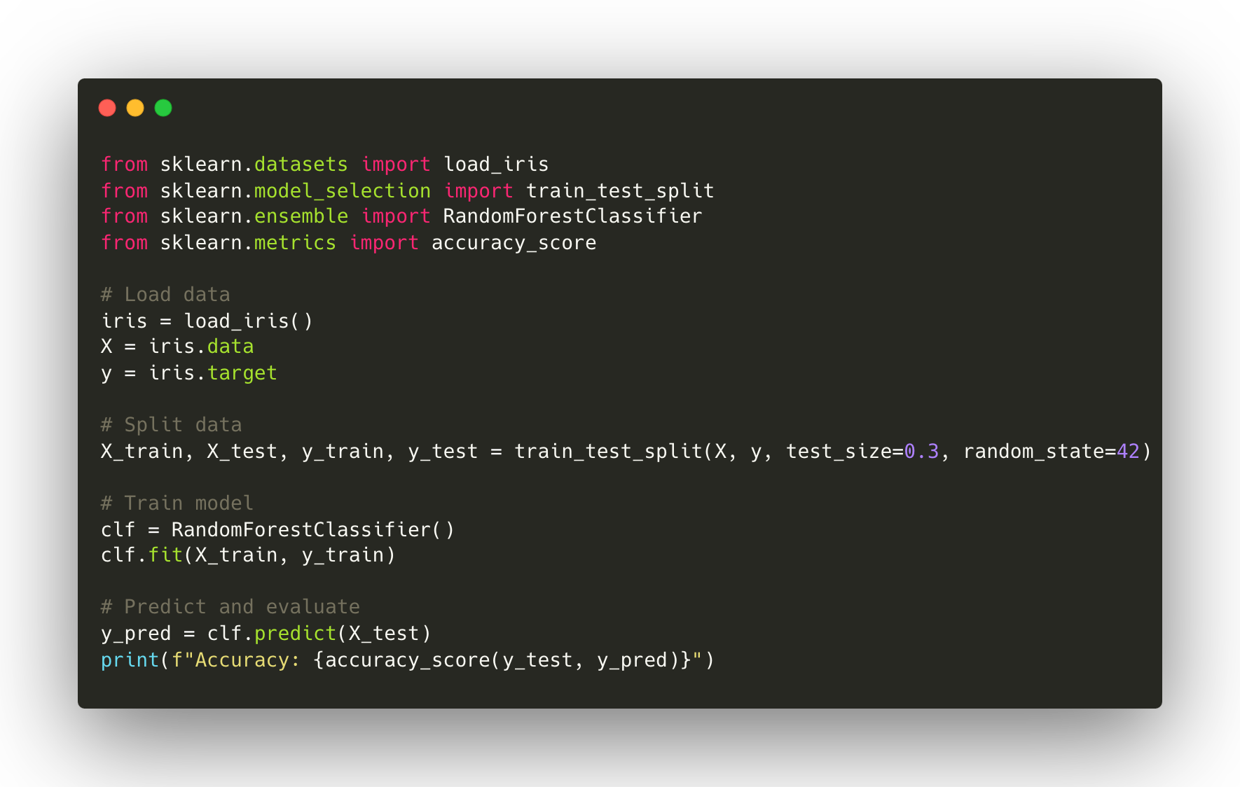
Code Example: Classification
Notes:
Let’s look at a practical example of classification using Scikit-Learn. Here, we’re using
the Iris dataset, a classic dataset in machine learning. First, we load the
dataset and split it into training and test sets. Then, we train a RandomForestClassifier
and evaluate its accuracy. The code looks like this:
Load the Iris dataset using load_iris().
Split the dataset into training and test sets with train_test_split().
Train a RandomForestClassifier using clf.fit().
Make predictions on the test set and evaluate accuracy with accuracy_score().
"Here, we load the Iris dataset, split it, train the model, and finally, predict and evaluate the accuracy.
This example highlights how straightforward it is to implement a classification model with Scikit-Learn."

Slide 7
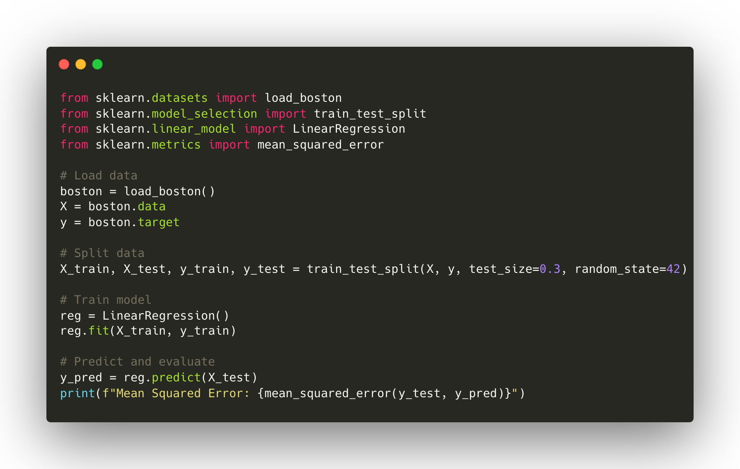
Code Example: Regression
Notes:
Now, let’s see an example of regression. We’ll use the Boston housing dataset to predict house prices. Here’s the code:
Load the Boston housing dataset using load_boston().
Split the dataset into training and test sets with train_test_split().
Train a LinearRegression model using reg.fit().
Make predictions on the test set and evaluate performance with mean_squared_error().
"This script loads the Boston dataset, splits it, trains a LinearRegression model,
and evaluates its performance using the mean squared error metric. It demonstrates
the ease of implementing regression tasks with Scikit-Learn.

Slide 8
Live Demo
Practical example using Jupyter Notebook, including data loading, model training, prediction, and evaluation. Interactive with the audience.
Notes:
Next, we'll move on to the live demo. I’ll show you a complete workflow in Jupyter Notebook.
We’ll load data, train a model, make predictions, and evaluate the results.
This interactive session will allow you to see Scikit-Learn in action and ask any questions you might have.
CONCLUSION:
To wrap up, we’ve covered what Scikit-Learn is, its uses, advantages, and limitations.
We also saw practical examples of classification and regression. Scikit-Learn is a versatile
and user-friendly library that plays a significant role in the machine learning ecosystem.
Now, I’d be happy to take any questions you might have.

